Slide 1
Lecture Notes on Power Electronics

Slide 2
MODULE - 1

Slide 3
POWER ELECTRONICS
The control of electric motor drives requires control of electric power. Power electronics have eased the concept of power control. Power electronics signifies the word power electronics and control or we can say the electronic that deal with power equipment for power control.
Main power source
Ref signal
Control Circuit
Digital Circuit
Power Electronic circuit
Load
Feedback Signal
Power electronics based on the switching of power semiconductor devices. With the development of power semiconductor technology, the power handling capabilities and switching speed of power devices have been improved tremendously.
Power Semiconductor Devices
The first SCR was developed in late 1957. Power semiconductor devices are broadly categorized into 3 types:
Power diodes
Transistors
Thyristors
(600V,4500A)
(10KV,300A,30MW)
Thyristor is a four layer three junction pnpn semiconductor switching device. It has 3 terminals these are anode, cathode and gate. SCRs are solid state device, so they are compact, possess high reliability and have low loss.

Slide 4
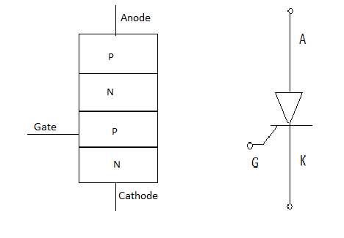
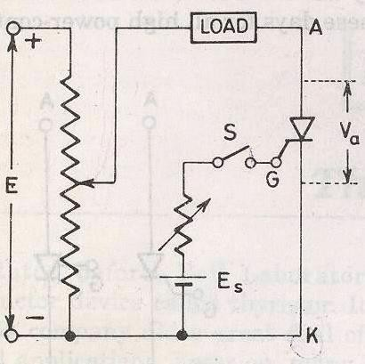
SCR is made up of silicon, it act as a rectifier; it has very low resistance in the forward direction and high resistance in the reverse direction. It is a unidirectional device.
Static V-I characteristics of a Thyristor
The circuit diagram for obtaining static V-I characteristics is as shown
Anode and cathode are connected to main source voltage through the load. The gate and cathode are fed from source 𝐸_{𝑆}.
A typical SCR V-I characteristic is as shown below:

Slide 5
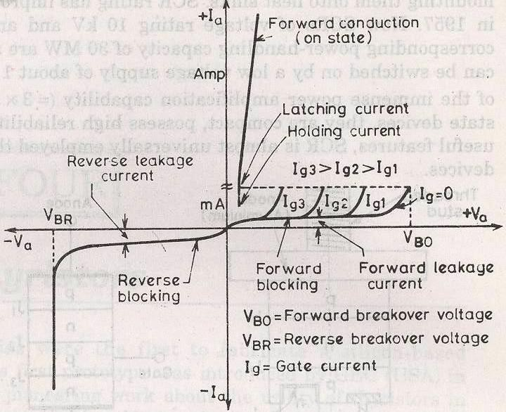
𝑉_{𝐵𝑂}=Forward breakover voltage
𝑉_{𝐵𝑅}=Reverse breakover voltage
𝐼_{𝑔}=Gate current
𝑉_{𝑎}=Anode voltage across the thyristor terminal A,K.
𝐼_{𝑎}=Anode current
It can be inferred from the static V-I characteristic of SCR. SCR have 3 modes of operation:
Reverse blocking mode
Forward blocking mode ( off state)
Forward conduction mode (on state)
Reverse Blocking Mode
When cathode of the thyristor is made positive with respect to anode with switch open thyristor is reverse biased. Junctions 𝐽₁ and 𝐽₂ are reverse biased where junction 𝐽₂ is forward biased. The device behaves as if two diodes are connected in series with reverse voltage applied across them.
  A small leakage current of the order of few mA only flows. As the thyristor is reverse biased and in blocking mode. It is called as acting in reverse blocking mode of operation.
  Now if the reverse voltage is increased, at a critical breakdown level called reverse breakdown voltage 𝑉_{𝐵𝑅},an avalanche occurs at 𝐽₁ and 𝐽₃ and the reverse

Slide 6
current increases rapidly. As a large current associated with 𝑉_{𝐵𝑅} and hence more losses to the SCR.
This results in Thyristor damage as junction temperature may exceed its maximum temperature rise.
Forward Blocking Mode
When anode is positive with respect to cathode, with gate circuit open, thyristor is said to be forward biased.
Thus junction 𝐽₁ and 𝐽₃ are forward biased and 𝐽₂ is reverse biased. As the forward voltage is increases junction 𝐽₂ will have an avalanche breakdown at a voltage called forward breakover voltage𝑉_{𝐵𝑂}. When forward voltage is less then 𝑉_{𝐵𝑂}thyristor offers high impedance. Thus a thyristor acts as an open switch in forward blocking mode.
Forward Conduction Mode
Here thyristor conducts current from anode to cathode with a very small voltage drop across it. So a thyristor can be brought from forward blocking mode to forward conducting mode:
  By exceeding the forward breakover voltage.
  By applying a gate pulse between gate and cathode.
During forward conduction mode of operation thyristor is in on state and behave like a close switch. Voltage drop is of the order of 1 to 2mV. This small voltage drop is due to ohmic drop across the four layers of the device.
Different turn ON methods for SCR
Forward voltage triggering
Gate triggering
^{𝑑𝑣} triggering
𝑑𝑡
Light triggering
Temperature triggering
1. Forward voltage triggering

Slide 7
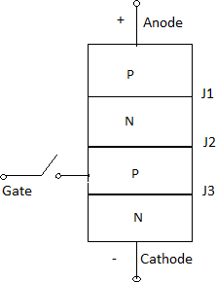
A forward voltage is applied between anode and cathode with gate circuit open.
Junction 𝐽₁ and 𝐽₃ is forward biased.
Juntion 𝐽₂ is reverse biased.
As the anode to cathode voltage is increased breakdown of the reverse biased junction
𝐽₂ occurs. This is known as avalanche breakdown and the voltage at which this phenomena occurs is called forward breakover voltage.
The conduction of current continues even if the anode cathode voltage reduces below
𝑉_{𝐵𝑂}till 𝐼_{𝑎} will not go below𝐼_{ℎ}. Where 𝐼_{ℎ} is the holding current for the thyristor.
2. Gate triggering
This is the simplest, reliable and efficient method of firing the forward biased SCRs. First SCR is forward biased. Then a positive gate voltage is applied between gate and cathode. In practice the transition from OFF state to ON state by exceeding 𝑉_{𝐵𝑂} is never employed as it may destroy the device. The magnitude of 𝑉_{𝐵𝑂}, so forward breakover voltage is taken as final voltage rating of the device during the design of SCR application.
First step is to choose a thyristor with forward breakover voltage (say 800V) higher than the normal working voltage. The benefit is that the thyristor will be in blocking state with normal working voltage applied across the anode and cathode with gate open. When we require the turning ON of a SCR a positive gate voltage between gate and cathode is applied. The point to be noted that cathode n- layer is heavily doped as compared to gate p-layer. So when gate supply is given between gate and cathode gate p-layer is flooded with electron from cathode n-layer. Now the thyristor is forward biased, so some of these electron reach junction 𝐽₂ .As a result width of 𝐽₂ breaks down or conduction at 𝐽₂ occur at a voltage less than 𝑉_{𝐵𝑂} .As 𝐼_{𝑔} increases 𝑉_{𝐵𝑂} reduces which decreases then turn ON time. Another important point is duration for which the gate current is applied should be more then turn ON time. This means

Slide 8
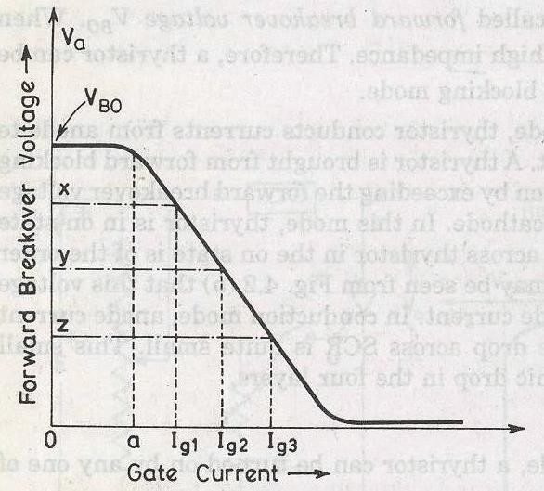
that if the gate current is reduced to zero before the anode current reaches a minimum value known as holding current, SCR can’t turn ON.
In this process power loss is less and also low applied voltage is required for triggering.
3. dv/dt triggering
This is a turning ON method but it may lead to destruction of SCR and so it must be avoided.
When SCR is forward biased, junction 𝐽₁ and 𝐽₃ are forward biased and junction 𝐽₂ is reversed biased so it behaves as if an insulator is place between two conducting plate. Here 𝐽₁ and 𝐽₃ acts as a conducting plate and 𝐽₂ acts as an insulator. 𝐽₂ is known as junction capacitor. So if we increase the rate of change of forward voltage instead of increasing the magnitude of voltage. Junction 𝐽₂ breaks and starts conducting. A high value of changing current may
damage the SCR. So SCR may be protected from high^{𝑑𝑣}.
𝑑𝑡
𝑞 = 𝑐𝑣
𝐼
𝑎
_{= 𝑐} 𝑑𝑣
𝑑𝑡
_{𝐼 𝛼} 𝑑𝑣
𝑎
𝑑𝑡
4. Temperature triggering
During forward biased, 𝐽₂ is reverse biased so a leakage forward current always associated with SCR. Now as we know the leakage current is temperature dependant, so if we increase the temperature the leakage current will also increase and heat dissipitation of junction
𝐽₂occurs. When this heat reaches a sufficient value 𝐽₂ will break and conduction starts.
Disadvantages

Slide 9
This type of triggering causes local hot spot and may cause thermal run away of the device.
This triggering cannot be controlled easily. It is very costly as protection is costly.
Light triggering
First a new recess niche is made in the inner p-layer. When this recess is irradiated, then free charge carriers (electron and hole) are generated. Now if the intensity is increased above a certain value then it leads to turn ON of SCR. Such SCR are known as Light activated SCR (LASCR).
Some definitions:
Latching current
The latching current may be defined as the minimum value of anode current which at must attain during turn ON process to maintain conduction even if gate signal is removed.
Holding current
It is the minimum value of anode current below which if it falls, the SCR will turn OFF.
Switching characteristics of thyristors
The time variation of voltage across the thyristor and current through it during turn on and turn off process gives the dynamic or switching characteristic of SCR.
Switching characteristic during turn on Turn on time
It is the time during which it changes from forward blocking state to ON state. Total turn on time is divided into 3 intervals:
  Delay time
  Rise time
  Spread time
Delay time
If 𝐼_{𝑔}and 𝐼_{𝑎} represent the final value of gate current and anode current. Then the delay time can be explained as time during which the gate current attains 0.9 𝐼_{𝑔} to the instant anode current reaches 0.1 𝐼_{𝑔} or the anode current rises from forward leakage current to 0.1 𝐼_{𝑎}.
1. Gate current 0.9 𝐼_{𝑔} to 0.1 𝐼_{𝑎}.
Anode voltage falls from 𝑉_{𝑎} to 0.9𝑉_{𝑎}.
Anode current rises from forward leakage current to 0.1 𝐼_{𝑎}.

Slide 10
Rise time (𝒕_{𝒓})
Time during which
Anode current rises from 0.1 𝐼_{𝑎} to 0.9 𝐼_{𝑎}
Forward blocking voltage falls from 0.9𝑉_{𝑎} to 0.1𝑉_{𝑎}. 𝑉_{𝑎} is the initial forward blocking voltage.
Spread time (𝒕_{𝒑})
Time taken by the anode current to rise from 0.9𝐼_{𝑎} to𝐼_{𝑎}.
Time for the forward voltage to fall from 0.1𝑉_{𝑜} to on state voltage drop of 1 to 1.5V. During turn on, SCR is considered to be a charge controlled device. A certain amount of charge is injected in the gate region to begin conduction. So higher the magnitude of gate current it requires less time to inject the charges. Thus turn on time is reduced by using large magnitude of gate current.
How the distribution of charge occurs?
As the gate current begins to flow from gate to cathode with the application of gate signal. Gate current has a non uniform distribution of current density over the cathode surface. Distribution of current density is much higher near the gate. The density decrease as the distance from the gate increases. So anode current flows in a narrow region near gate where gate current densities are highest. From the beginning of rise time the anode current starts spreading itself. The anode current spread at a rate of 0.1mm/sec. The spreading anode current requires some time if the rise time is not sufficient then the anode current cannot spread over the entire region of cathode. Now a large anode current is applied and also a large anode current flowing through the SCR. As a result turn on losses is high. As these losses occur over a small conducting region so local hot spots may form and it may damage the device.
Switching Characteristics During Turn Off
Thyristor turn off means it changed from ON to OFF state. Once thyristor is oON there is no role of gate. As we know thyristor can be made turn OFF by reducing the anode current below the latching current. Here we assume the latching current to be zero ampere. If a forward voltage is applied across the SCR at the moment it reaches zero then SCR will not be able to block this forward voltage. Because the charges trapped in the 4- layer are still favourable for conduction and it may turn on the device. So to avoid such a case, SCR is reverse biased for some time even if the anode current has reached to zero.
So now the turn off time can be different as the instant anode current becomes zero to the instant when SCR regains its forward blocking capability.
𝑡_{𝑞}=𝑡_{𝑟𝑟}+𝑡_{𝑞𝑟} Where,

Slide 11
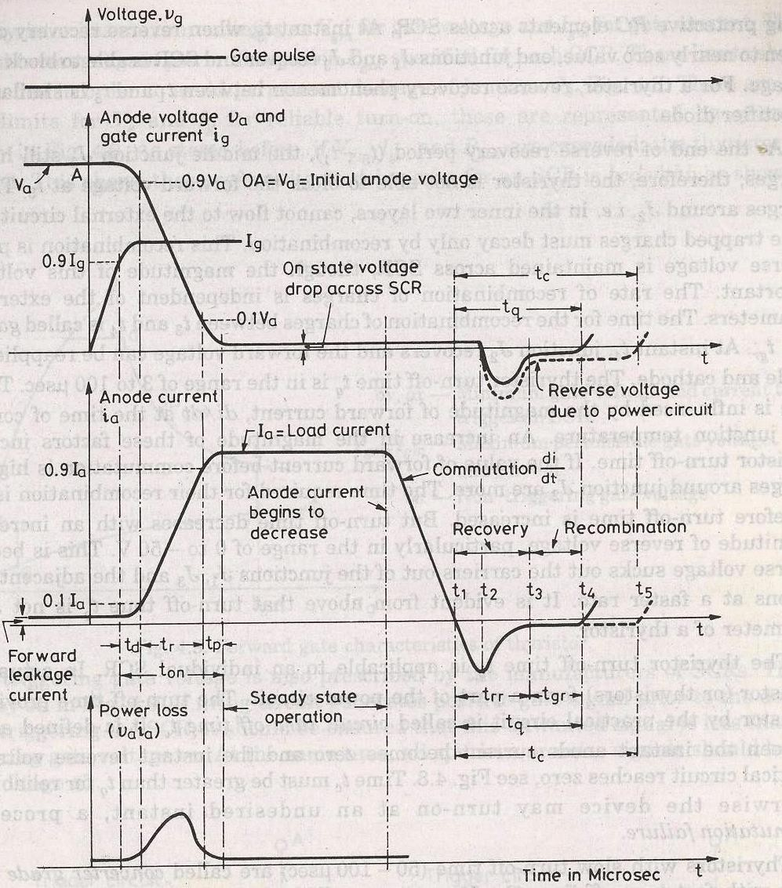
𝑡_{𝑞} is the turn off time,𝑡_{𝑟𝑟} is the reverse recovery time, 𝑡_{𝑞𝑟} is the gate recovery time
At 𝑡₁ anode current is zero. Now anode current builds up in reverse direction with same
^{𝑑𝑣} slope. This is due to the presence of charge carriers in the four layers. The reverse
𝑑𝑡
recovery current removes the excess carriers from 𝐽₁ and 𝐽₃ between the instants 𝑡₁ and𝑡₃.
At instant 𝑡₃ the end junction 𝐽₁ and 𝐽₃ is recovered. But 𝐽₂ still has trapped charges which decay due to recombination only so the reverse voltage has to be maintained for some more time. The time taken for the recombination of charges between 𝑡₃ and 𝑡₄ is called
gate recovery time 𝑡_{𝑞𝑟}. Junction 𝐽₂ recovered and now a forward voltage can be applied across SCR.
The turn off time is affected by:
Junction temperature
Magnitude of forward current ^{𝑑𝑖} during commutation.
𝑑𝑡
Turn off time decreases with the increase of magnitude of reverse applied voltage.
GTO(Gate turn off thyristor)

Slide 12



A gate turn off thyristor is a pnpn device. In which it can be turned ON like an ordinary SCR by a positive gate current. However it can be easily turned off by a negative gate pulse of appropriate magnitude.
Conventional SCR are turned on by a positive gate signal but once the SCR is turned on gate loses control over it. So to turn it off we require external commutation circuit. These commutation circuits are bulky and costly. So due to these drawbacks GTO comes into existence.
The salient features of GTO are:
GTO turned on like conventional SCR and is turned off by a negative gate signal of sufficient magnitude.
It is a non latching device.
GTO reduces acoustic and electromagnetic noise.
It has high switching frequency and efficiency.
A gate turn off thyristor can turn on like an ordinary thyristor but it is turn off by negative gate pulse of appropriate magnitude.
Disadvantage
The negative gate current required to turn off a GTO is quite large that is 20% to 30 % of anode current
Advantage
It is compact and cost less
Switching performance

Slide 13
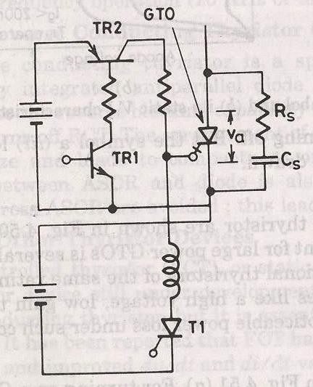
For turning ON a GTO first TR1is turned on.
This in turn switches on TR2 so that a positive gate current pulse is applied to turn on the GTO.
Thyristor 𝑇₁ is used to apply a high peak negative gate current pulse.
Gate turn-on characteristics
The gate turn on characteristics is similar to a thyristor. Total turn on time consists of delay time, rise time, spread time.
The turn on time can be reduced by increasing its forward gate current.

Slide 14
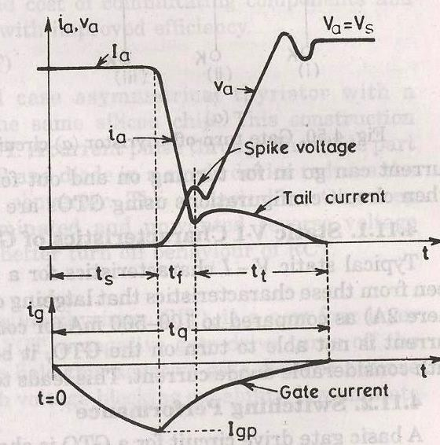
GATE TURN OFF
Turn off time is different for SCR.Turn off characteristics is divied into 3 pd
Storage time
Fall time
Tail time
Tq=ts+tf+tt
At normal operating condition gto carries a steady state current.The turn off process starts as soon as negative current is applied after t=0.
STORAGE TIME
During the storagepd the anode voltage and current remains constant.The gate current rises depending upon the gate circuit impedance and gate applied voltage.The beginning of pd is as soon as negative gate current is applied.The end of storage pd is marked by fall in anode current and rise in voltage,what we have to do is remove the excess carriers.the excess carriers are removed by negative carriers.

Slide 15
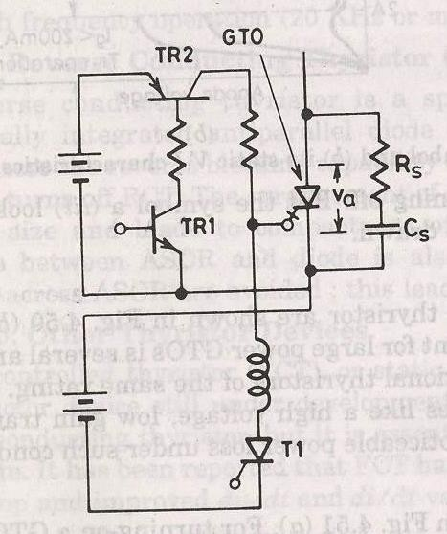
FALL TIME
After ts, anode current begins to fall rapidly and anode voltage starts rising.After falling to a certain value,then anode current changes its rate to fall.this time is called fall time.
SPIKE IN VOLTAGE
During the time of storage and fall timethere is achange in voltage due to abrupt current change. TAIL TIME
During this time ,the anode current and voltage continues towards the turn off values.The transient overshoot is due to the snubber parameter and voltage stabilizes to steady state value.

Slide 16
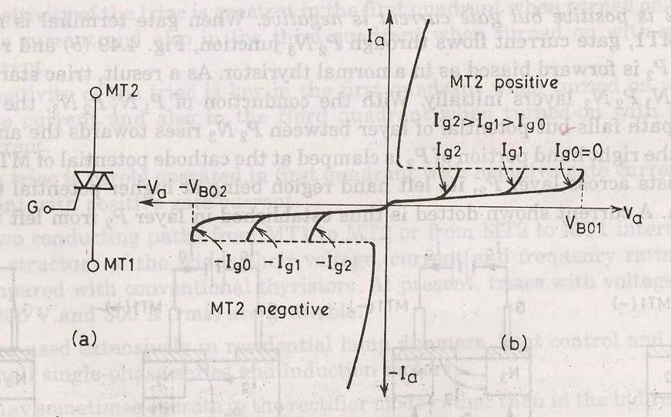
THE TRIAC
As SCR is a unidirectional device,the conduction is from anode to cathode and not from cathode to anode. It conducts in both direction.It is a bidirectional SCR with three terminal.
TRIAC=TRIODE+AC
Here it is considered to be two SCRS connected in anti parallel.As it conducts in both direction so it is named as MT1,MT2 and gate G.
SALIENT FEATURES
Bi directional triode thyristor
TRIAC means triode that works on ac 3.It conduct in both direction
4.It is a controlled device

Slide 17
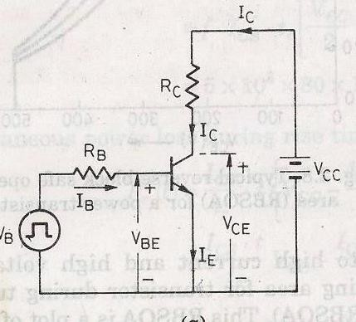
Its operation is similar to two devices connected in anti parallel with common gate connection.
It has 3 terminals MT1,MT2 and gate G Its use is control of power in ac.
POWER BJT
Power BJT means a large voltage blocking in the OFF state and high current carrying capability in the ON state. In most power application, base is the input terminal. Emitter is the common terminal.
Collector is the output terminal.
SIGNAL LEVEL OF BJT
n+ doped emitter layer ,doping of base is more than collector.Depletion layer exists more towards the collector than emitter

Slide 18
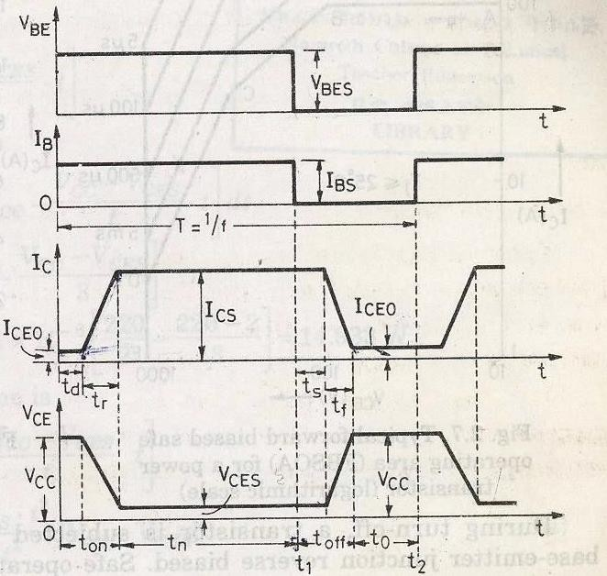
POWER BJT CONSTRUCTION
The maxium collector emitter voltage that can be sustained across the junction, when it is carrying substantial collector current.
Vceo=maxium collectorand emitter voltage that can be sustain by the device. Vcbo=collector base breakdown voltage with emitter open
PRIMARY BREAKDOWN
It is due to convention avalanche breakdown of the C-B junction and its associated large flow of current.The thickness of the depletion region determines the breakdown voltage of the transistor.The base thickness is made as small as possible,in order to have good amplification capability. If the thickness is too small, the breakdown voltage is compromised.So a compromise has to be made between the two.

Slide 19
THE DOPING LEVELS-
1.The doping of the emitter layer is quite large. 2.The base doping is moderate.
3.n- region is lightly doped.
4.n+ region doping level is similar to emitter. 1.THICKNESS OF DRIFT REGION-
It determines the breakdown length of the transistor.
2.THE BASE THICKNES –
Small base thickness- good amplification capability
Too small base thickness- the breakdown voltage of the transistor has ti be compromised.
For a relatively thick base,the current gain will be relatively small.so it is increase the gain.Monolithicesigns for darlington connected BJT pair have been deveploed.
SECONDARY BREAKDOWN
Secondary breakdown is due to large power disspation at localized site within the semi conductor.
PHYSICS OF BJT OPERATION-
The transistor is assumed to operate in active region. There is no doped collector drift region. It has importance only in switching operation, in active region of operation.
B-E junction is forward biased and C-B junction is reverse biased. Electrons are injected into base from the emitter. Holes are injected from base into the emitter.
QUASI SATURATION-
Intially we assume that, the transistor is in active region. Base current is allowed to increase then lets see what happens.first collector rises in response to base current.So there is a increase voltage drop across the collector load.So C-E voltage drops.
Because of increase in collector current, there is a increase in voltage in drift region. This eventually reduces the reverse biased across the C-B junction.so n-p junction get smaller, at some point the junction become forward bised. So now injection of holes from base into collector drift region occurs. Charge neutrality requires the electron to be injected in the drift region of the holes. From where these electron came. Since a large no of electron is supplied to the C-B junction via injection from emitter and subsequent diffusion across the base. As excess carrier build up in the drift region begins to occur quasi saturation region is entered. As the injected carrires increase in the drift region is

Slide 20
gradually shotred out and the voltage across the drift region drops. In quasi saturation the drift region is not completely shorted out by high level injection.Hard saturation obtained when excess carrier density reaches the n+ side.
During quasi saturation, the rate of the collector fall.Hard saturation occurs when excess carriers have completely swept across the drift region .
THYRISTOR PROTECTION
OVER VOLTAGE PROTECTION
Over voltage occurring during the switching operation causes
the failure of SCR.
INTERNAL OVERVOLTAGE
It is due to the operating condition of SCR.

Slide 21
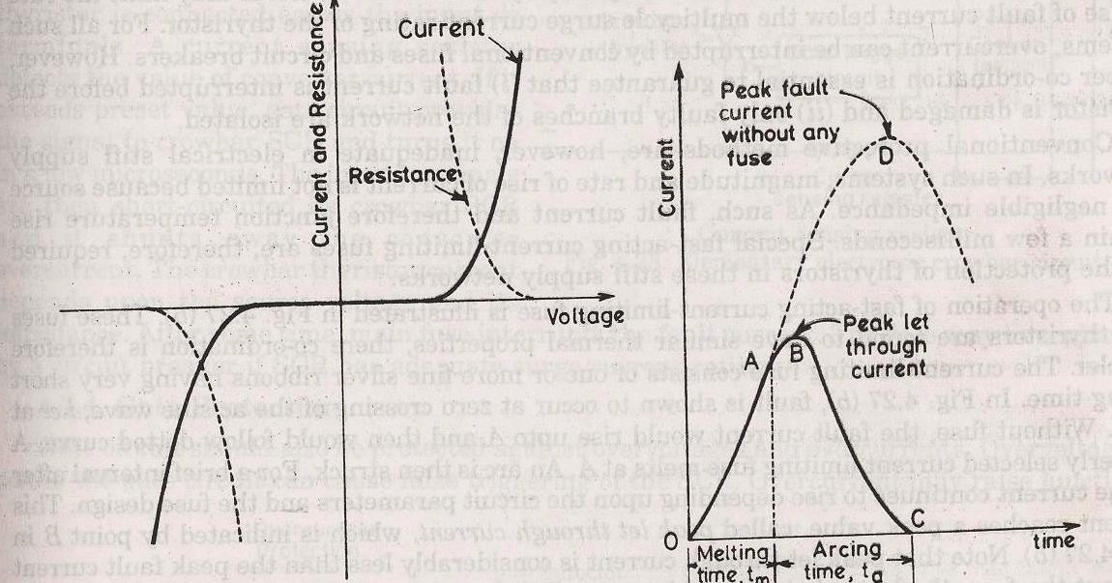
During the commutation of SCR ,when the anode current decays to zero anode current reverses due to stored changes. First the reverse current rises to peak value, then reverse
current reduces abruptly with large ^{𝑑𝑖}⁄_{𝑑𝑡}. During series inductance of SCR large
transient large voltage i.e 𝐿 ^{𝑑𝑖}⁄_{𝑑𝑡}. is generated.
EXTERNAL OVER VOLTAGE
This is due to external supply and load condition. This is because of
The interruption of current flow in an inductive circuit.
Lightening strokes on the lines feeding the thyristor systems.
Suppose a SCR converter is fed from a transformer, voltage transient transformer primary will energise or de-energised.
occur
when
This overvoltages cause random turn ON of a SCR. The effect of overvoltage is minimized using
RC circuits
Non linear resistor called voltage clamping device.
Voltage clamping device is a non linear resistor.It is connected between cathode and anode of SCR. The resistance of voltage clamping device decreases with increasing voltages. During normal working condition Voltage clamping (V.C) device has high resistance, drawing only leakage current. When voltage surge appears voltage clamping device offers a low resistance and it create a virtual short circuit across the SCR. Hence voltage across SCR is clamped to a safe value.

Slide 22
When surge condition over voltage clamping device returns to high resistance state.
e.g. of voltage clamping device
Seleniumthyrector diodes 2.Metal Oxide varistors 3.Avalanche diode supressors
OVER CURRENT PROTECTION
Long duration operation of SCR, during over current causes the 1.junction temp. of SCR to rise above the rated value,causing permanent damage to device.
SCR is protected from overcurrent by using 1.Circuit breakers
Fast acting fuses
Proper co-ordination is essential because
1..fault current has to be interrupted before SCR gets damaged. 2.only faulty branches of the network has to be replaced.
In stiff supply network,source has negligible impedance.So in such system the magnitude and rate of rise of current is not limited.Fault current hence
junction temp rises in a few miliseconds. POINTS TO BE NOTED-
Proper coordination between fast acting fuse and thyristor is essential.
The fuse is always rated to carry definite period.
The peak let through current through rating of the SCR.
marginal overload current over
SCR must be less than sub cycle
arcing time is called arcing or
4. The voltage across the fuse during
recovery voltage and is equal to sum of the source voltage and emf induced in the circuit inductance during arcing time.
5. On abrupt interruption of fuse current, induce emf would be high, which results in high arcing voltage.
Circuit Breaker (C.B)
C.B. has long tripping time. So it is used for protecting the device against continuous overload current or against the surge current for long duration. In order that fuse protects the thyristor realiably the 𝐼²𝑡 rating of fuse current must be less than that of SCR.
ELECTRONIC CROWBAR PROTECTION

Slide 23
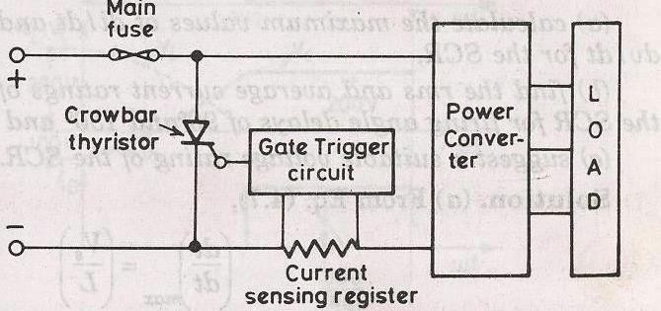
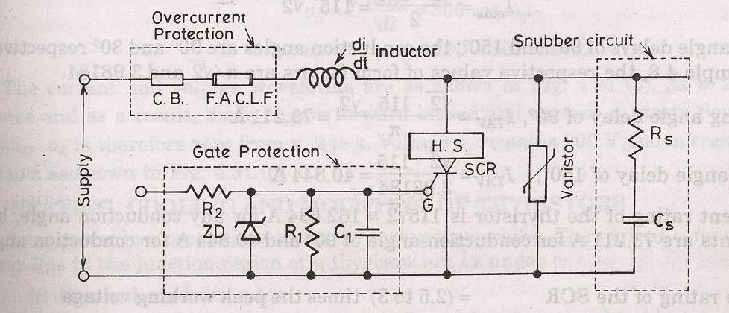
For overcurrent protection of power converter using SCR, electronic crowbar are
used. It provide rapid isolation of power converter before any damage
occurs.
HEAT PROTECTION-
To protect the SCR
From the local spots
Temp rise
SCRs are mounted over heat sinks.
GATE
PROTECTION-
Gate circuit should also be protected from
Overvoltages
Overcurrents
Overvoltage across the gate circuit causes the false triggering of SCR

Slide 24
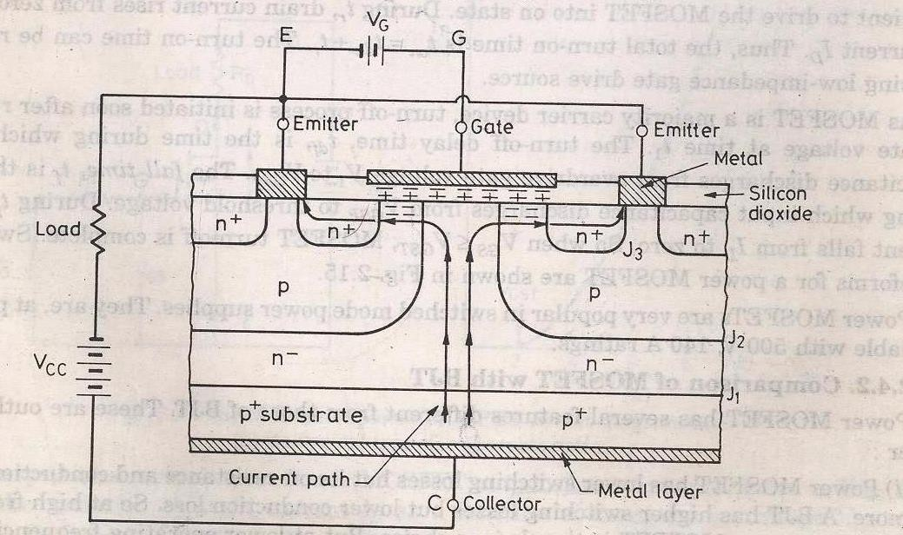
Overcurrent raise the junction temperature. Overvoltage protection is by zener the gate circuit.
INSULATED GATE BIPOLAR TRANSISTOR(IGBT)-
diode across
BASIC CONSTRUCTION-
The n+ layer substrate at the drain in the power MOSFET is substituted by p+ layer substrate and called as collector. When gate to emitter voltage is positive,n- channel is formed in the p- region.This n- channel short circuit the n- and n+ layer and an electron movement in n channel cause hole injection from p+subtrate layer to n- layer.

Slide 25
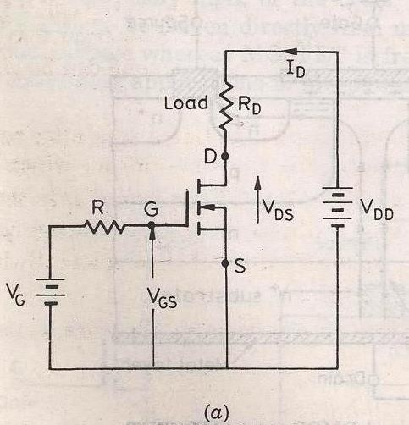
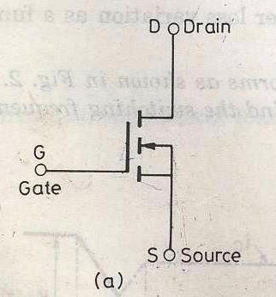
POWER MOSFET
A power MOSFET has three terminal device. Arrow indicates the direction of current flow. MOSFET is a voltage controlled device. The operation of MOSFET depends on flow of majority carriers only.
(Circuit diagram)
(circuit symbol)
Switching Characteristics:-
The switching characteristic is influenced by
Internal capacitance of the device.
Internal impedance of the gate drive circuit. Total turn on time is divided into
1.Turn on delay time 2.Rise time
Turn on time is affected by impedance of gate drive source. During turn on delay time gate to source voltage attends its threshold value 𝑉_{𝐺𝑆𝑇}.
After 𝑡_{𝑑𝑛} and during rise time gate to source voltage rise to 𝑉_{𝐺𝑠𝑝}, a voltage which is sufficient to drive the MOSFET to ON state.
The turn off process is initiated by removing the gate to source voltage. Turn off time is composed of turn off delay time to fall time.
Turn off delay time

Slide 26
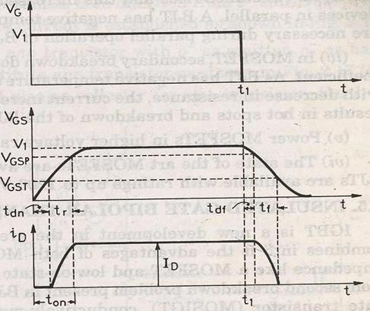
To turn off the MOSFET the input capacitance has to be discharged . During 𝑡_{𝑑𝑓} the input capacitance discharge from 𝑉₁to 𝑉_{𝐺𝑠𝑝}. During 𝑡_{𝑓} , fall time ,the input capacitance discharges from 𝑉_{𝐺𝑠𝑝} to 𝑉_{𝐺𝑆𝑇}. During 𝑡_{𝑓} drain current falls from 𝐼_{𝐷} to zero.
So when 𝑉_{𝐺𝑠} ≤ 𝑉_{𝐺𝑆𝑇} , MOFSET turn off is complete.
Fig. Switching waveform of power MOSFET
Insulated Gate Bipolar Transistor (IGBT)
IGBT has high input impedance like MOFFSET and low on state power lose as in BJT.
IGBT Characteristics
Here the controlling parameter is gate emitter voltage As IGBT is a voltage controlled device. When 𝑉_{𝐺𝐸} is less than 𝑉_{𝐺𝐸𝑇} that is gate emitter threshold voltage IGBT is in off state.

Slide 27
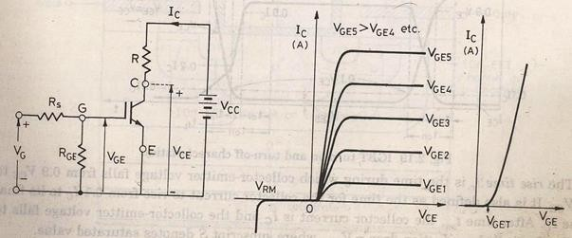
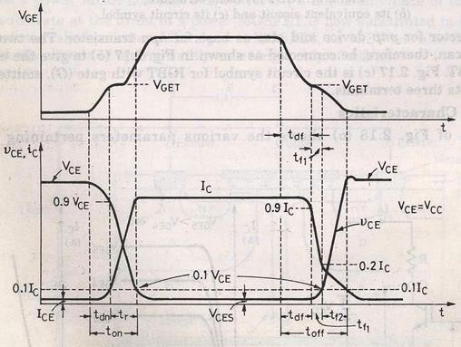
Fig. a Fig. b.
Fig. a (Circuit diagram for obtaining V-I characteristics) characteristics)
Fig. c
Fig. b (Static V-I
Fig. c (Transfer characteristic)
Switching characteristics: Figure below shows the turn ON and turn OFF characteristics of IGBT
Turn on time

Slide 28
Time between the instants forward blocking state to forward on -state .
Turn on time = Delay time + Rise time
Delay time = Time for collector emitter voltage fall from 𝑉_{𝐶𝐸} to 0.9𝑉_{𝐶𝐸}
𝑉_{𝐶𝐸}=Initial collector emitter voltage
𝑡_{𝑑𝑛}=collector current to rise from initial leakage current to 0.1Ic Ic= Final value of collector current
Rise time
Collector emitter voltage to fall from 0.9𝑉_{𝐶𝐸} to 0.1𝑉_{𝐶𝐸} .
  Ic to Ic
After 𝑡_{𝑜𝑛} the device is on state the device carries a steady current of Ic and the collector emitter voltage falls to a small value called conduction drop 𝑉_{𝐶𝐸𝑆}.
Turn off time
    Delay time 𝑡_{𝑑𝑓}
    Initial fall time 𝑡_{𝑓1}
    Final fall time 𝑡_{𝑓2}
𝑡_{𝑂𝑓𝑓} =𝑡_{𝑑𝑓} + 𝑡_{𝑓1+} 𝑡_{𝑓2}
𝑡_{𝑑𝑓} = Time during which the gate emitter voltage falls to the threshold value 𝑉_{𝐺𝐸𝑇} .
Collector current falls from Ic to 0.9Ic at the end of the 𝑡_{𝑑𝑓} collector emitter voltage begins to rise.
Turn off time = Collector current falls from 90% to 20% of its initial value Ic OR The time during which collector emitter voltage rise from 𝑉_{𝐶𝐸} to 0.1𝑉_{𝐶𝐸}.
𝑡_{𝑓2} = collector current falls from20% to 10% of Ic.
During this collector emitter voltage rise 0.1𝑉_{𝐶𝐸} to final value of 𝑉_{𝐶𝐸}. Series and parallel operation of SCR
SCR are connected in series for h.v demand and in parallel for fulfilling high current demand. Sting efficiency can be defined as measure of the degree of utilization on SCRs in a string.
String efficiency < 1. Derating factor (DRF)

Slide 29
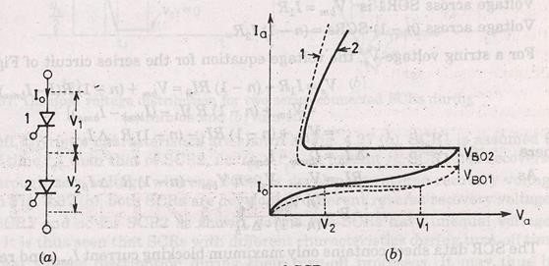
1 – string efficiency.
If DRF more then
no. of SCRs will more, so string is more reliable.
Let the rated blocking voltage of the string of a series connected SCR is 2𝑉₁ as shown in the figure below, But in the string two SCRs are supplied a maximum voltage of 𝑉₁+𝑉₂.
_{𝜂 =} 𝑉₁ + 𝑉₂
2𝑉₁
Significance of string efficiency .
Two SCRs are have same forward blocking voltage ,When system voltage is more then the voltage rating of a single SCR. SCRs are connected in series in a string.
There is a inherent variation in characteristics. So voltage shared by each SCR may not be equal. Suppose, SCR1 leakage resistance > SCR2 leakage resistance. For same leakage current 𝐼₀ in the series connected SCRs. For same leakage current SCR1 supports a voltage
𝑉₁ , SCR2 supports a voltage 𝑉_{2,}
So string 𝜂 for two SCRs = ^{𝑉1+𝑉2} = ¹(1 + ^{𝑉2}) < 1 .
2𝑉₂ 2 𝑉₁
So, 𝑉₁ > 𝑉_{2,}
The above operation is when SCRs are not turned ON. But in steady state of operation , A uniform voltage distribution in the state can be achieved by connect a suitable resistance across each SCRs , so that parallel combination have same resistance.
But this is a cumbersome work. During steady state operation we connect same value of shunt resistance across each SCRs. This shunt resistance is called state equalizing circuit.
Suppose,

Slide 30
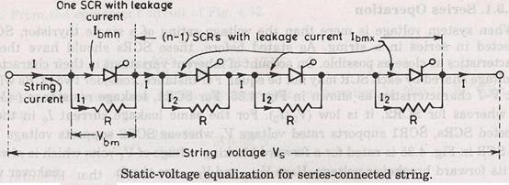
Let SCR1 has lower leakage current 𝐼_{𝑏𝑚𝑛} , It will block a voltage comparatively larger than other SCRs.
Voltage across SCR1 is 𝑉_{𝑏𝑚} =𝐼₁𝑅.
Voltage across (n-1)SCR is (n-1) 𝐼₂R, so the voltage equation for the series circuit is Vs = 𝐼₁𝑅+ (𝑛 − 1)𝐼₂𝑅 = 𝑉_{𝑏𝑚}+ (n-1)R (𝐼 − 𝐼_{𝑏𝑚𝑥} )
As 𝐼₁ = 𝐼 − 𝐼_{𝑏𝑚𝑛}
𝐼₂= 𝐼 − 𝐼_{𝑏𝑚𝑥}
So, Vs = 𝑉_{𝑏𝑚}+ (n-1)R [𝐼₁ − (𝐼_{𝑏𝑚𝑥} − 𝐼_{𝑏𝑚𝑛})]
If
^{Δ𝐼}𝑏 ^{= 𝐼}𝑏𝑚𝑥 ^{− 𝐼}𝑏𝑚𝑛
Then Vs = 𝑉_{𝑏𝑚}+(n-1)R (𝐼₁ − Δ𝐼_{𝑏})
Vs = 𝑉_{𝑏𝑚}+ (n-1)R 𝐼₁-(n-1)R Δ𝐼_{𝑏} R𝐼₁= 𝑉_{𝑏𝑚}
So, Vs = 𝑉𝑏𝑚+ (n-1) 𝑉𝑏𝑚 -(n-1)R Δ𝐼_{𝑏}
= n 𝑉_{𝑏𝑚}- (n-1)R Δ𝐼_{𝑏}
_{⇒R =} 𝑛𝑉_{𝑏𝑚}−𝑉_{𝑆}
(n−1)Δ𝐼_{𝑏}
SCR data sheet usually contain only maximum blocking current , 𝐼_{𝑏𝑚𝑥}
so we assume 𝐼_{𝑏𝑚𝑛} = 0
So Δ𝐼_{𝑏}=𝐼_{𝑏𝑚𝑥}
So the value of R calculated is low than actually required.
SCRs having unequal dynamic characteristics:

Slide 31
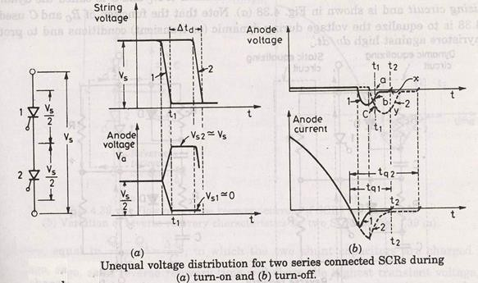
It may occur that SCRS may have unequal dynamic characteristics so the voltage distribution across the SCR may be unequal during the transient condition.
SCR 1 and SCR 2 have different dynamic characteristics. Turn ON time of SCR 2 is more than SCR 1 by time Δ𝑡_{𝑑} .
As string voltage is 𝑉_{𝑆} so voltage shared by each SCRs be 𝑉_{𝑆}/2. Now both are gated at same time so SCR 1 will turn ON at 𝑡₁ its voltage fall nearly to zero so the voltage shared by SCR 2 will be the string voltage if the break over voltage of SCR 2 is less than 𝑉_{𝑆} then SCR 2 will turn ON .
* In case 𝑉_{𝑆} is less than the breakoverer voltage, SCR 2 will turn ON at instant 2. SCR 1 assumed to have less turn off 𝑡_{𝑞1} time then SCR 2, so 𝑡_{𝑞1} < 𝑡_{𝑞2} . At 𝑡₂ SCR 1 has recovered while SCR 2 is developing recovery voltage at 𝑡₁ both are developing different reverse
recovery
At 𝑡₂ SCR 1 has recovered while SCR2 is developing reverse recovery voltage .
Conclusion :
voltage.
Series connected SCR develop different voltages during turn ON and turn OFF process. Till now we connect a simple resistor across the diode for static voltage equalizing circuit .
During turn ON and turn OFF capacitance of reverse biased junction determine the voltage distribution across SCRs in a series connected string . As reverse biased junction have different capacitance called self capacitance , the voltage distribution during turn ON and turn Off process would be different.

Slide 32
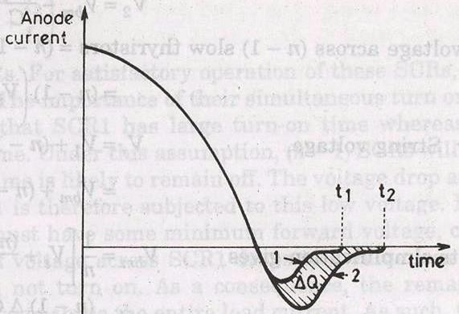
* Under transient condition equal voltage distribution can be achieved by employing shunt capacitance as this shunt capacitance has the effect of that the resultant of shunt and self capacitance tend to be equal. The capacitor is used to limits the dv/dt across the SCR during forward blocking state. When this SCR turned ON capacitor discharges heavy current through the SCR . The discharge current spike is limited by damping resistor 𝑅_{𝑐} . 𝑅_{𝑐} also damps out high frequency oscilation that may arise due to series combination of 𝑅_{𝑐} ,C and series inductor . 𝑅_{𝑐} & C are called dynamic equalizing circuit
Diode D is used during forward biased condition for more effective charging of the capacitor. During capacitor discharge 𝑅_{𝑐} comes into action for limiting current spike and rate of change of current di/dt .
The R, 𝑅_{𝑐} & C component also provide path to flow reverse recovery current. When one SCR regain its voltage blocking capability. The flow of reverse recovery current is necessary as it facilitates the turning OFF process of series connected SCR string. So C is necessary for both during turn ON and turn OFF process. But the voltage unbalance during turn OFF time is more predominant then turn ON time. So choice of C is based on reverse recovery characteristic of SCR .

Slide 33
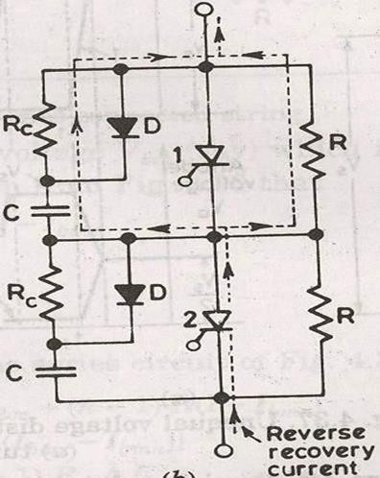
SCR 1 has short recovery time as compared to SCR 2. Δ_{𝑄} is the difference in reverse recovery charges of two SCR 1 and SCR 2. Now we assume the SCR 1 recovers fast . i.e it goes into blocking state so charge Δ_{𝑄} can pass through C . The voltage induced by 𝑐₁ is
𝛥_{𝑄} /C , where is no voltage induced across 𝐶₂ .
The difference in voltage to which the two shunt capacitor are charged is 𝛥_{𝑄} /C .
Now thyristor with least recovery time will share the highest transient
voltage say 𝑉_{𝑏𝑚},
So,
𝑉_{𝑏𝑚} - 𝑉₂ = Δ_{𝑄}/C
𝑉₂= 𝑉_{𝑏𝑚} - Δ_{𝑄}/C
𝑉₁ = 𝑉_{𝑏𝑚}
𝑉_{𝑆} = 𝑉₁+𝑉₂
= 𝑉_{𝑏𝑚}+(𝑉_{𝑏𝑚} - Δ_{𝑄}/C)
𝑉_{𝑆} = 2𝑉_{𝑏𝑚}-Δ_{𝑄}/C
So,
As
1 Δ
𝑄
⇒ (𝑉 + ) = 𝑉
𝑠
𝑏𝑚
2 𝐶
⇒ 𝑉₂= 𝑉_{𝑏𝑚} - Δ_{𝑄}/C
¹[𝑉_{𝑠} - Δ_{𝑄}/C]
2
Now suppose that there are n series SCRs in a string.

Slide 34
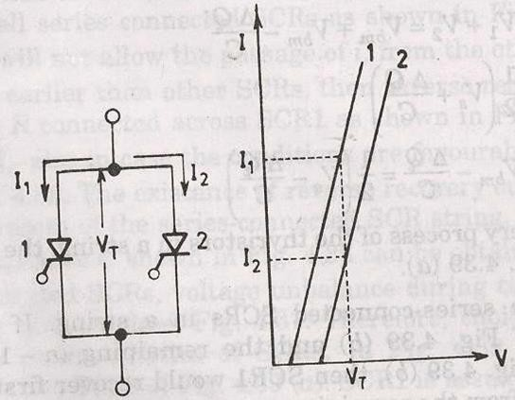
Let us assume that if top SCR has similar to characteristic SCR 1. Then SCR 1 would support a voltage 𝑉_{𝑏𝑚}
* If the remaining (n-1) SCR has characteristic that of SCR 2 .Then SCR 1 would recover first and support a voltage 𝑉_{𝑏𝑚} . The charge (n-1) Δ_{𝑄} from the remaining (n -
1) SCR would pass through C.
𝑉₁ = 𝑉_{𝑏𝑚}
𝑉₂ = 𝑉_{𝑏𝑚} - Δ_{𝑄}/C Voltage across (n-1) slow thyristors
𝑉 = (n-1) (𝑉_{𝑏𝑚} - Δ_{𝑄}/C)
𝑉_{𝑆} = V₁+(n-1) 𝑉₂
= 𝑉_{𝑏𝑚} + (n-1) (𝑉_{𝑏𝑚} - Δ_{𝑄}/C)
So,
By simplifing we get ,
𝑉_{𝑏𝑚} = ¹ [𝑉_{𝑠}+(n-1) Δ_{𝑄}/C ]
𝑛
C =[ (n-1) Δ_{𝑄}/( n𝑉_{𝑏𝑚} -𝑉_{𝑆})
𝑉₂ = (𝑉_{𝑆} - Δ_{𝑄}/C )/ n .
Parallel operation:
When current required by the load is more than the rated current of single thyristor , SCRs are connected in parallel in a string .

Slide 35
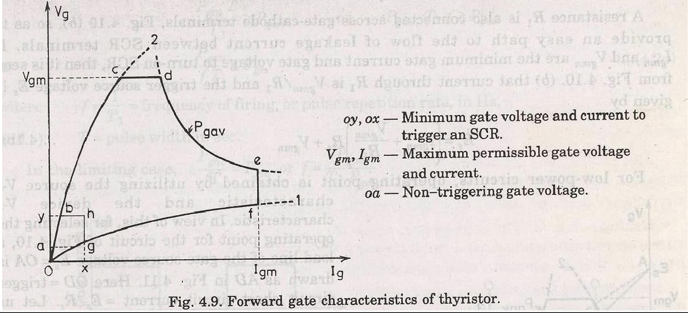
For equal sharing of current, SCRs must have same 𝑉 − 𝐼characteristics during forward conduction. 𝑉_{𝑇} across them must be same. For same 𝑉_{𝑇} , SCR 1 share 𝐼₁and SCR 2 share I₂ .
If 𝐼₁ is the rated current
𝐼₂ < 𝐼₁
The total current 𝐼₁+𝐼₂ and not rated current 2𝐼₁.Type equation here.
Thus string efficiency ,
𝐼₁+𝐼𝐼₂ ₌ 1 ₍₁ ₊ 𝐼𝐼₂₎
2𝐼₁ 2 𝐼₁
Middle conductor will have more inductance as compared to other two nearby conductor. As a result less current flow through the middle conductor. Another method is by magnetic coupling.
Thyristor gate characteristics:-
𝑉_{𝑔} = +ve gate to cathode voltage.
𝐼_{𝑔}= +ve gate to cathode current.
As the gate cathode characteristic of a thyrister is a p-n junction, gate characteristic of the device is similar to diode.
Curve 1 the lowest voltage value s that must be applied to turn on the
SCR.

Slide 36
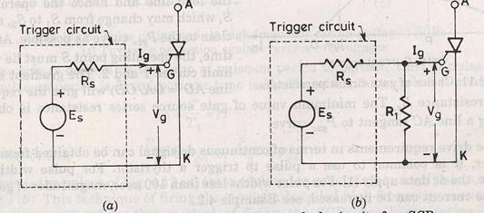
Curve 2 highest possible voltage values that can be safely applied to get circuit.
𝑉_{gm}= Maximum limit for gate voltage .
𝐼_{gm}= Maximum imilt for gate current.
𝑃_{gav} = Rated gate power dissipation for each SCR.
These limits should not be crossed in order to avoid the permanent damage of the device junction 𝐽₃.
OY = Minimum limit of gate voltage to turn ON . OX = minimum limit of gate current to turn ON.
If
^{𝑉}gm^{, 𝐼}gm^{, 𝑃}gav
are exceeded the thyristor will damage so the preferred gate drive area
of SCR is bcdefghb.
oa = The non triggering gate voltage , If firing circuit generates +ve gate signal prior to the desired instant of triggering the SCR.It should be ensured that this un wanted signal should be less than the non –triggering voltage oa.
𝐸_{𝑆} = 𝑉_{𝑔} + 𝐼_{𝑔}𝑅_{𝑆}
𝐸_{𝑆} =Gate source voltage
𝑉_{𝑔} = Gate cathode voltage
𝐼_{𝑔} = Gate current
𝑅_{𝑆} = Gate source resistance
𝑅_{𝑆} = The internal resistance of the trigger source
𝑅₁ is connected across the gate cathode terminal, which provides an easy path to the flow of leakage current between SCR terminal. If 𝐼_{𝑔𝑚𝑛} , 𝑉_{gmn} are the minimum gate current and gate voltage to turn ON the SCR.
𝐸_{𝑆} = (𝐼_{𝑔𝑚𝑛}+ 𝑉_{gmn}/ 𝑅₁) 𝑅_{𝑆} + 𝑉_{𝑔𝑚𝑛}

Slide 37
MODULE-II

Slide 38
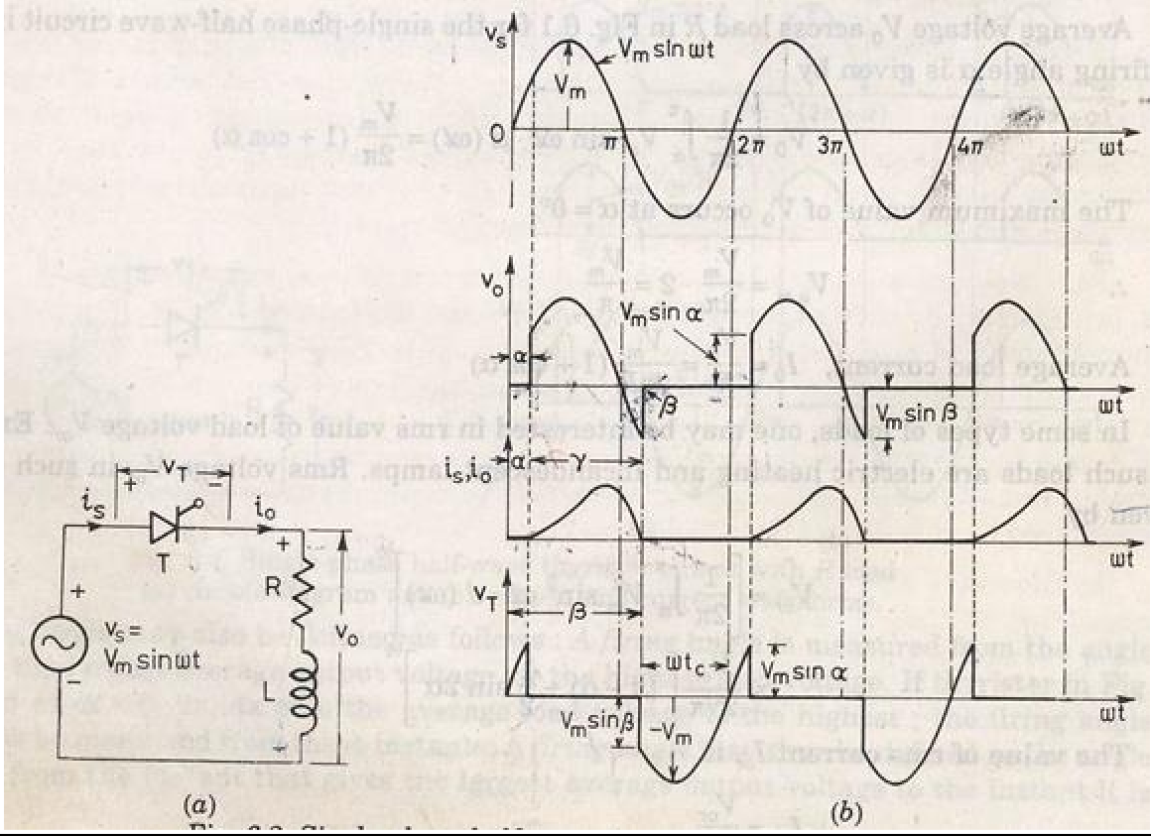
RECTIFIER
Rectifier are used to convert A.C to D.C supply.
Rectifiers can be classified as single phase rectifier and three phase rectifier. Single phase rectifier are classified as 1-Փ half wave and 1-Փ full wave rectifier. Three phase rectifier are classified as 3-Փ half wave rectifier and 3-Փ full wave rectifier. 1-Փ Full wave rectifier are classified as1-Փ mid point type and 1-Փ bridge type rectifier. 1-Փ bridge type rectifier are classified as 1-Փ half controlled and 1-Փ full controlled rectifier. 3-Փ full wave rectifier are again classified as 3-Փ mid point type and 3-Փ bridge type rectifier. 3-Փ bridge type rectifier are again divided as 3-Փ half controlled rectifier and 3-Փ full controlled rectifier.
Single phase half wave circuit with R-L load
Output current 𝑖_{𝑜} rises gradually. After some time 𝑖_{𝑜} reaches a maximum value and then begins to decrease.
At π, 𝑣_{𝑜}=0 but 𝑖_{𝑜} is not zero because of the load inductance L. After π interval SCR is reverse biased but load current is not less then the holding current.
At β>π, 𝑖_{𝑜} reduces to zero and SCR is turned off.
At 2π+β SCR triggers again α is the firing angle.

Slide 39
β is the extinction angle.
v = β −α = conduction angle
Analysis for 𝑉_{𝑇}.
At 𝜔𝑡 = 𝐼,𝑉_{𝑇} = 𝑉_{𝑚}𝑠𝑖𝑛𝐼 During = 𝐼 𝑡𝑜 𝐼 , 𝑉_{𝑇} = 0; When = 𝐼 , 𝑉_{𝑇} = 𝑉_{𝑚}𝑠𝑖𝑛𝐼;
V_{m} sin ωt = Ri₀
_{L} di₀
dt
i =
V_{m}
sin(ω t−φ)
s
R² + X ²
Where,
φ = tan^{−1 X}
R
X = ωL
Where 𝐼 is the angle by which 𝐼_{𝑠} lags 𝑉_{𝑠}. The transient component can be obtained as
Ri + L ^{di0} = 0
t
dt
_{So 𝑖𝑡 = 𝐴𝑒}−(𝑅𝑡⁄𝐿)
𝑖₀ = 𝑖_{𝑠} + 𝑖_{𝑡}
^{𝑉𝑚} sin( 𝜔𝑡 − 𝐼) + 𝐴𝑒^{−(𝑅𝑡⁄𝐿)}
𝑧
Where 𝑧 = √𝑅² + 𝑋²
At 𝛼 = 𝜔𝑡, 𝑖_{𝑜} = 0;
0 = ^{𝑉𝑚} sin( 𝛼 − 𝐼) + 𝐴𝑒^{−(𝑅𝛼⁄𝐿𝜔)};
𝑧
𝐴 = ^{−𝑉𝑚} sin( 𝛼 − 𝐼)𝑒^{(𝑅𝛼⁄𝐿𝜔)}
𝑧
𝑖 = ^{𝑉𝑚} sin( 𝜔𝑡 − 𝐼) − ^{𝑉𝑚} sin( 𝛼 − 𝐼)𝑒^{−𝑅(𝜔𝑡−𝛼)⁄𝐿𝜔}
𝑜
𝑧 𝑧

Slide 40
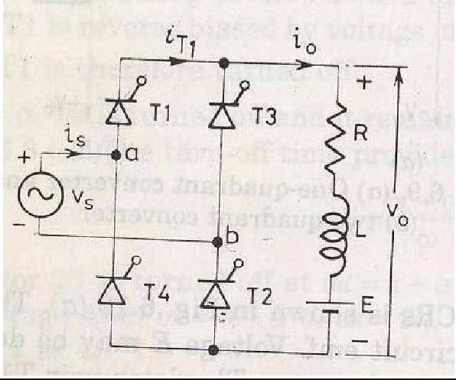
Therefore,
𝜔𝑡 = 𝛽, 𝑖₀ = 0;
So sin(𝛽 − 𝛼) = sin(𝛼 − 𝐼)𝑒^{−(𝛽−𝛼)/(𝜔𝐿)}
β can obtained from the above equation. The average load voltage can be given by
₁ β
V₀ = _{2π ∫}V_{m} sin ωtd (ωt)
α
^{𝑉𝑚} (cos(𝛼) − cos(𝛽))
2𝜋
Average load current
I
0
₌ V_{m}
(cosα − cos β )
2π R
Single phase full converter
₁ π +β
V₀ = _{π ∫} V_{m} sin(ωt)d (ωt)
α
= ^{2Vm} cosα
π
T₁,T₂ triggered at α and π radian latter T₃, T₄ are triggered.

Slide 41
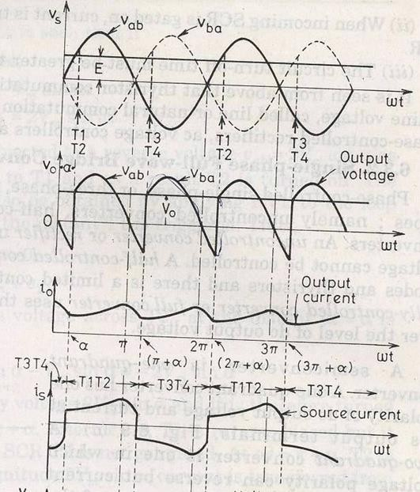
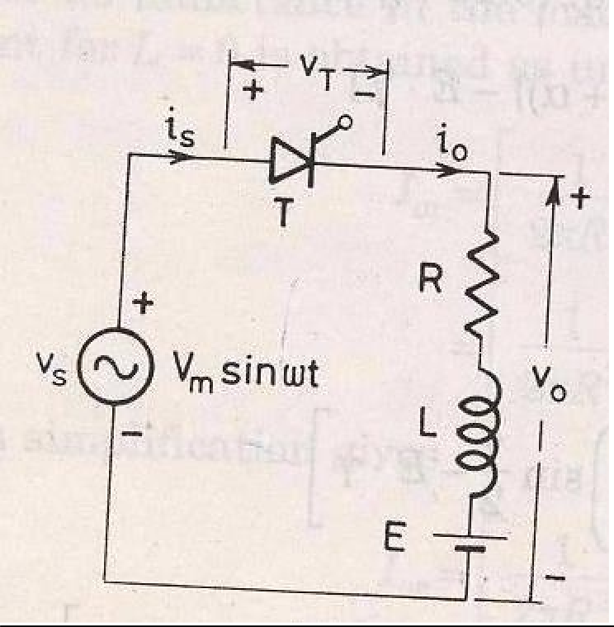
Single phase half wave circuit with RLE load
The minimum value of firing angle is

Slide 42
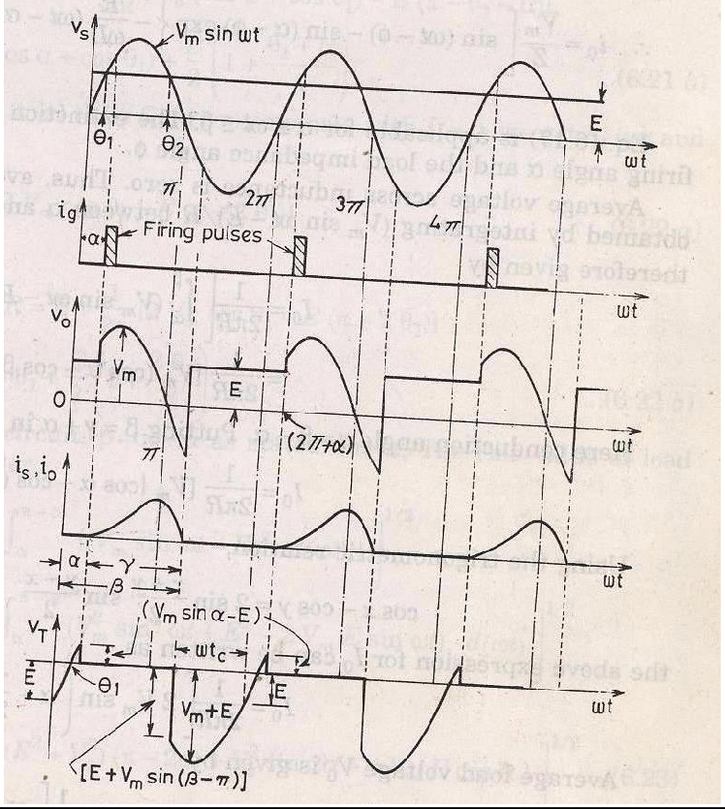
V_{m} sin(ωt) = E
So,
θ = sin
−1
E
1
V
m
Maximum value of firing angle
θ₂ = π −θ₂
The voltage differential equation is
V sin(ωt) = Ri + L ^{di0} + E
m 0
dt
i_{s} = i_{s1} + i_{s 2}
Due to source volt
i = ^{Vm} sin(ωt −φ)
s1
Z
Due to DC counter emf

Slide 43
i_{s 2} = −(E / R)
_{i = Ae}−( R/ L)t t
Thus the total current is given by
i_{s1} + i_{s 2} + i_{t}
= ^{Vm} sin(ωt −φ) − ^{E} + Ae^{−(R/L) t}
Z R
i = ^{Vm} sin(ωt −φ) − ^{E} + Ae^{−(R/L) t}
s0
Z R
At ωt = α,i₀ = 0
A = [ ^{E} − ^{Vm} sin(α −φ)]e^{− Rα / Lω}
R Z
So
₌ V
{ ^{− R} (ωt −α )}
E
{ ^{− R} (ωt −α )}
i ^{m} [sin(ωt −φ) −sin(α −φ)e ^{ωL}
− [1− e ^{ωL}
R
]
0
Z
Average voltage across the inductance is zero. Average value of load current is
I =
1
β
(V_{m} sin ωt − E) d(ωt)
0
2π R ^{∫α}
=
1
2π R
[V (cosα − cos β ) − Ε(β −α )]
m
Conduction angle ^{ν = β −α}
⇒ β = α + v
I =
1
2π R
[V (cosα − cos(α + v)) − Ε(v)]
0
m
cos A − cosB = 2sin ^{A + B} sin ^{A − B}
2 2
So
I =
1
2π R
[2V sin(α + ^{v} ) sin ^{v} − E.ν ]
0
m
2 2

Slide 44
ν = E + I₀ R
= E+ ¹ [2V sin(α + ^{v} ) sin ^{v} − E.ν ]
m
2π 2 2
v
= E(1− ^{v} ) +[^{Vm} sin(α + ^{v} ) sin ]
2π π 2 2
If load inductance L is zero then
β = θ₂
_{And} v = β −α = θ₂ −α
θ = π −θ
But ² ¹
β = θ = π −θ
_{So} 2 1
_{And} v = π −θ₁ −α
So average current will be
I =
1
2π R
[V_{m} (cosα − cos(π −θ₁ )) − E(π −θ₁ −α )]
0
So V₀=E+I₀R
V
E θ + α
= (cosα + cosθ ) + (1+
)
m
1
1
2π 2 π
For no inductance rms value of load current
1
π −α
(V_{m} sin(ω
t) − E) d (ωt )]
I = [
2π R^{2 ∫α}
2
1/2
0
Power delivered to load
P = I ² R + I E
or 0
Supply power factor
I ² R + I E
_{Pf =} or 0
^{V}s ^{I}or
Single phase full wave converter:

Slide 45
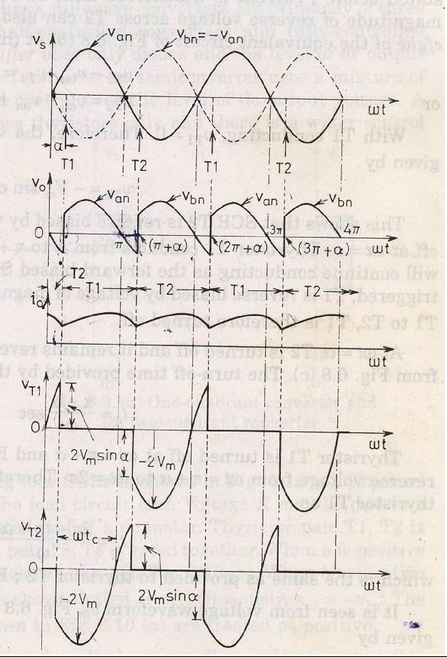

Slide 46
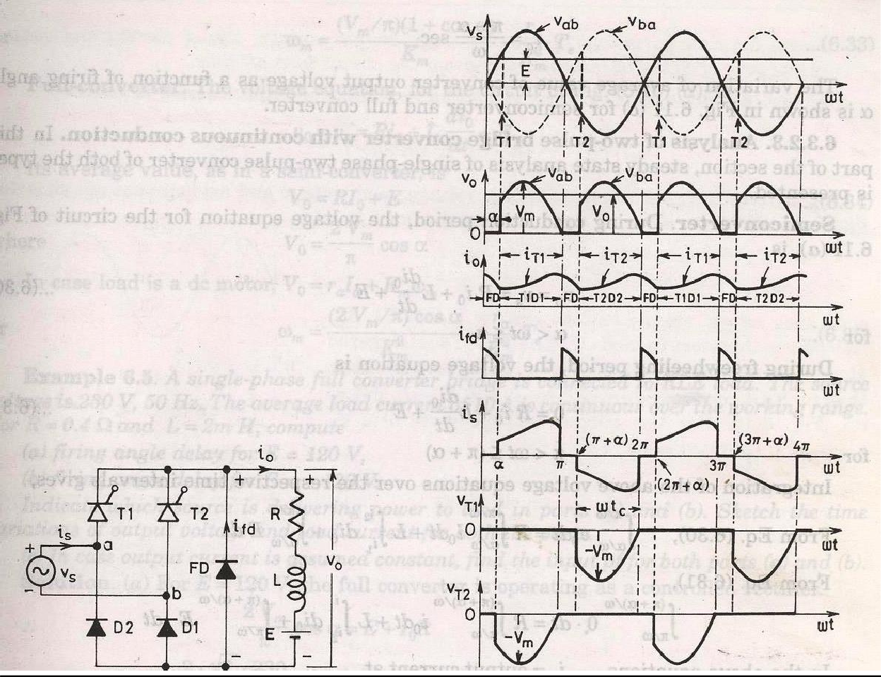
∫
π +α
ωt)d (ωt)
V = ¹ V sin(
0
π
α
m
= ^{2Vm} sinα
π
Single phase semi converter:
∫
π
ωt)d (ωt)
V = ¹ V sin(
0
π
α
m
= ^{Vm} cosα
π

